Slide 1
Forms of Energy
Mechanical
  Kinetic, gravitational
Thermal
  Microscopic mechanical
Electromagnetic
Nuclear
Energy is conserved!

Slide 2
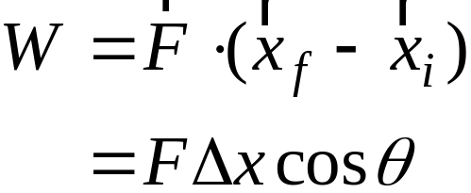
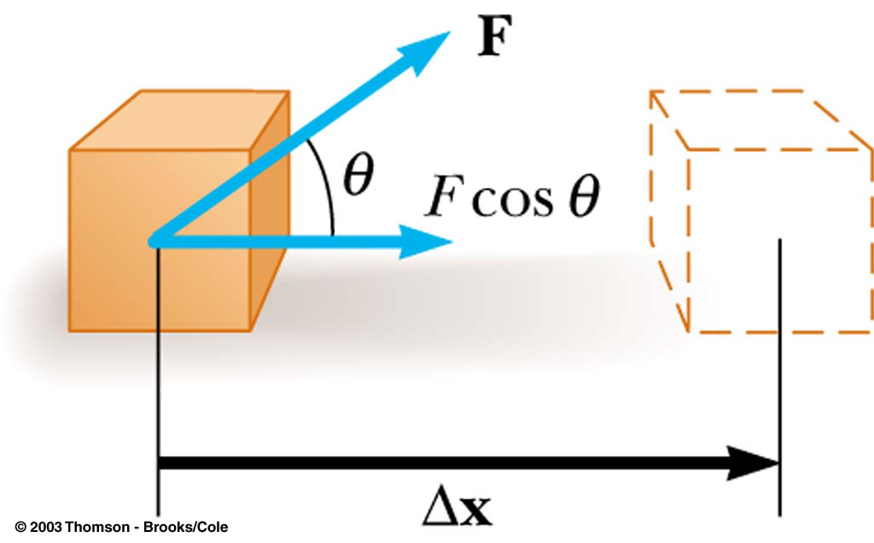
Work
Relates force to change in energy
Scalar quantity
Independent of time

Slide 3

Units of Work and Energy
SI unit = Joule
1 J = 1 N⋅m = 1 kg⋅m²/s²

Slide 4
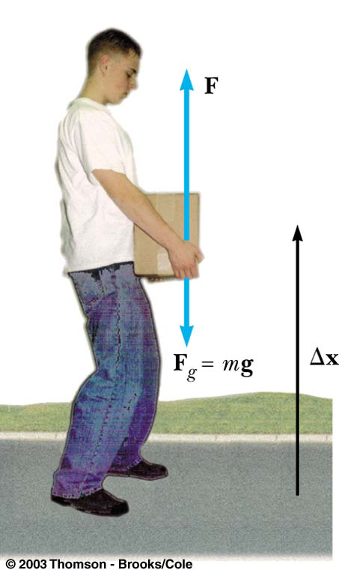
Work can be positive or negative
Man does positive work
lifting box
Man does negative work
lowering box
Gravity does positive work when box lowers
Gravity does negative work when box is raised

Slide 5
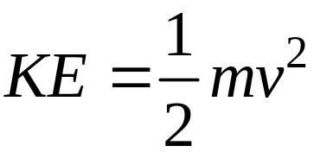
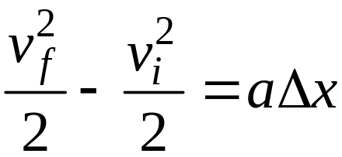
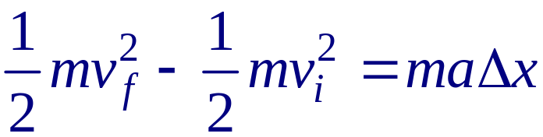

Kinetic Energy
Same units as work
Remember the Eq. of motion
Multiply both sides by m,

Slide 6
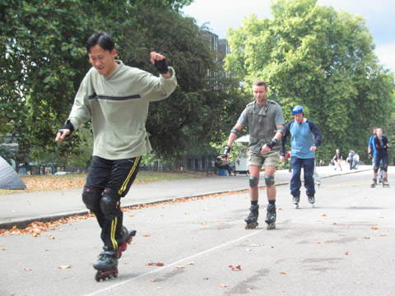
Example 5.1
A skater of mass 60 kg has an initial velocity of 12 m/s. He slides on ice where the frictional force is 36 N. How far will the skater slide before he stops?
120 m

Slide 7

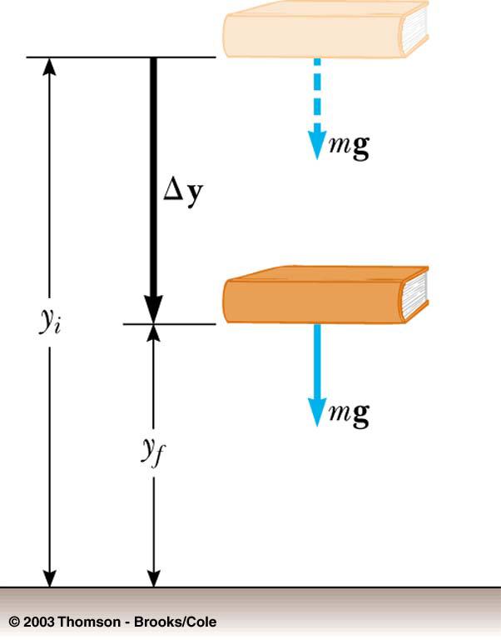

Potential Energy
If force depends on distance,
For gravity (near Earth’s surface)

Slide 8
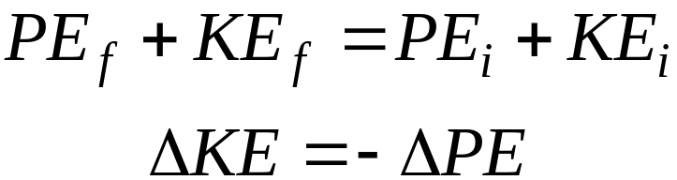
Conservation of Energy
Conservative forces:
Gravity, electrical, QCD…
Non-conservative forces:
Friction, air resistance…
Non-conservative forces still conserve energy!
Energy just transfers to thermal energy

Slide 9
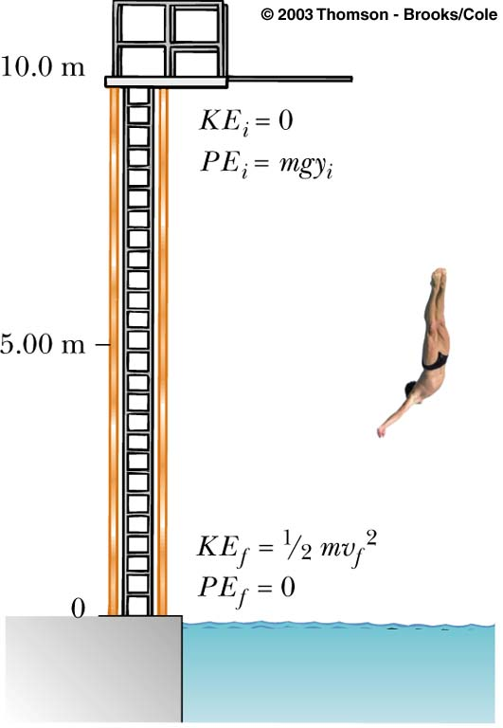
Example 5.2
A diver of mass m drops from a board 10.0 m above the water surface, as in the Figure. Find his speed 5.00 m above the water surface. Neglect air resistance.
9.9 m/s

Slide 10

Example 5.3
A skier slides down the frictionless slope as shown. What is the skier’s speed at the bottom?
start
H=40 m
finish
L=250 m
28.0 m/s

Slide 11
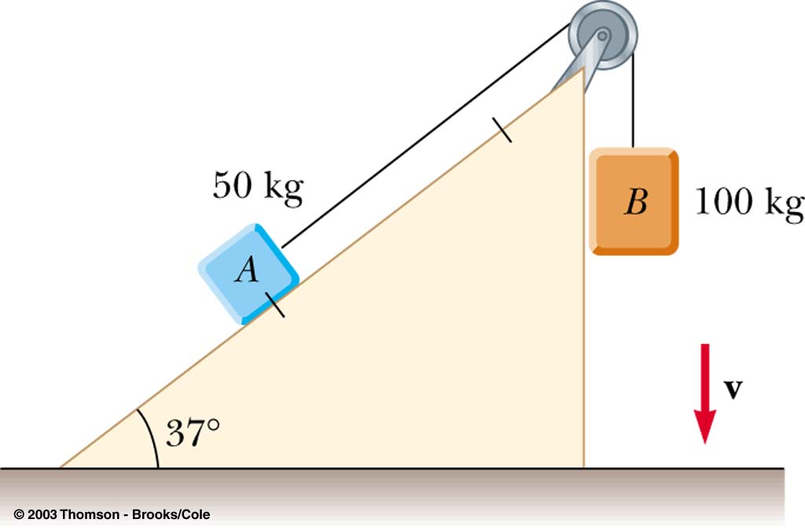
Example 5.4
Two blocks, A and B (m_{A}=50 kg and m_{B}=100 kg), are connected by a string as shown. If the blocks begin
at rest, what will their speeds be after A has slid
a distance s = 0.25 m? Assume the pulley and incline are frictionless.
1.51 m/s
s

Slide 12
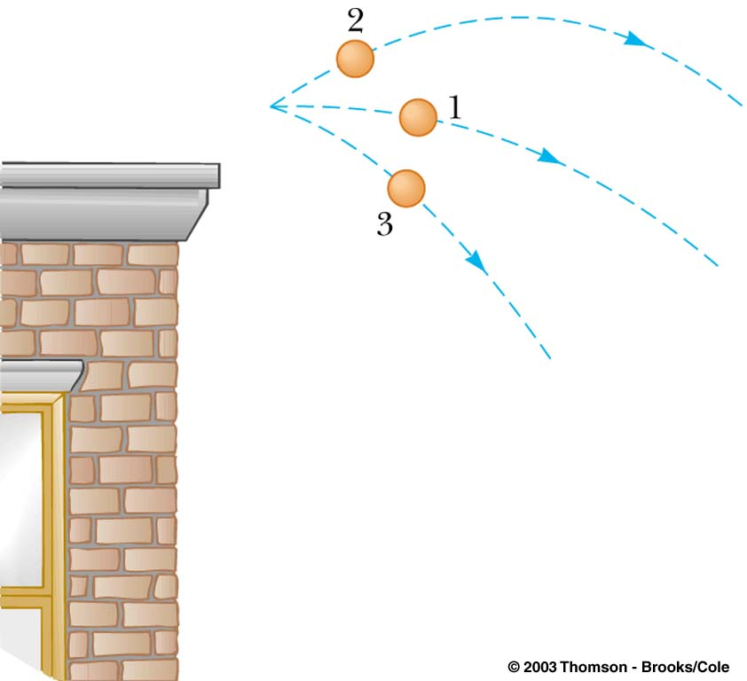
Example 5.5
Three identical balls are thrown from the top of a building with the same initial speed. Initially,
Ball 1 moves horizontally.
Ball 2 moves upward.
Ball 3 moves downward.
Neglecting air resistance, which ball has the fastest speed when it hits the ground?
A) Ball 1
B) Ball 2
C) Ball 3
D) All have the same speed.

Slide 13

Example 5.6
Tarzan swings from a vine whose length is 12 m. If Tarzan starts at an angle of 30 degrees with respect to the vertical and has no initial speed, what is his speed at the bottom of the arc?
5.61 m/s

Slide 14
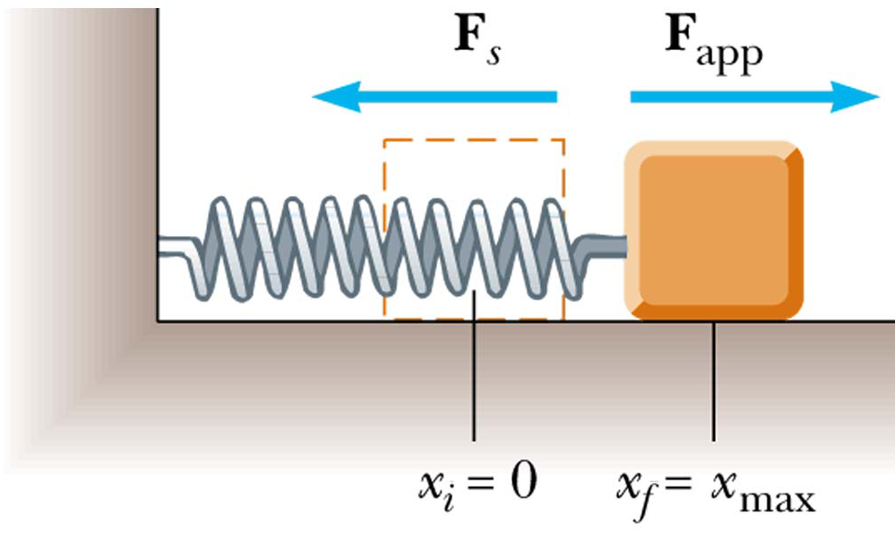

Springs (Hooke’s Law)
Proportional to displacement from equilibrium

Slide 15
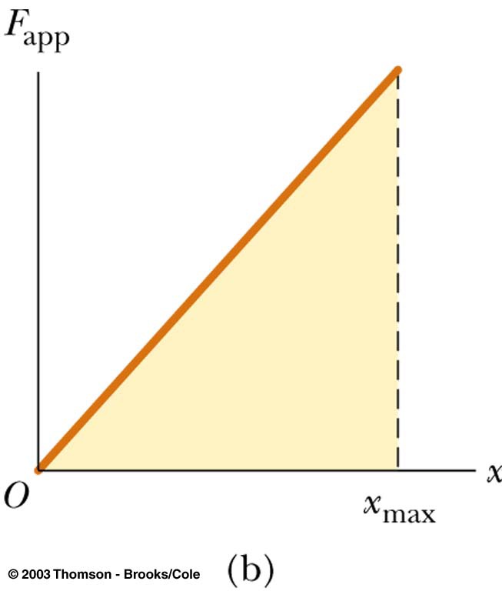
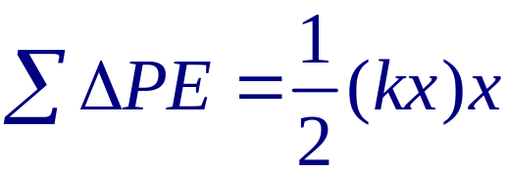
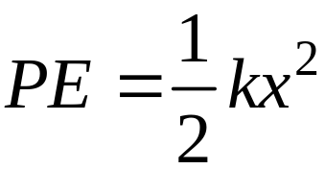
Potential Energy of Spring
ΔPE=-FΔx
F
Δx

Slide 16
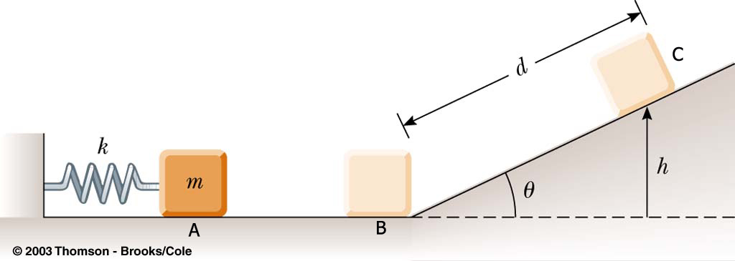
Example 5.7
A 0.50-kg block rests on a horizontal, frictionless surface as in the figure; it is pressed against a light spring having a spring constant of k = 800 N/m, with an initial compression of 2.0 cm.
x
b) To what height h does the block rise when moving up the incline?
3.2 cm

Slide 17

Graphical connection between F and PE
F
x
x₁
Δx
x₂

Slide 18
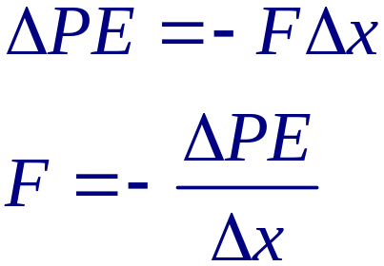
Graphical connection between F and PE
PE
F = -slope, points down hill
x

Slide 19
Graphs of F and PE for spring
PE=(1/2)kx²
F=-kx
x
x
Force pushes you to bottom of potential well

Slide 20
Example 5.8a
60
PE (J)
50
40
Release point
30
20
10
A
0
0
1.0
2.0
3.0
4.0
At point 'A', which are zero?
a) force
b) acceleration
c) force and acceleration
d) velocity
x (m)

Slide 21
Example 5.8b
60
PE (J)
50
40
Release point
30
20
B
10
0
0
1.0
2.0
3.0
4.0
At point 'B', which are zero?
a) force
b) acceleration
c) force and acceleration
d) velocity
e) kinetic energy
x (m)

Slide 22
Example 5.8c
60
PE (J)
50
A
I
40
Release point
B
30
E
H
20
D
C
F
10
G
0
0
1.0
2.0
3.0
4.0
All points for which force is negative (to the left):
a) C, E and G
b) B and F
c) A and I
d) D and H
e) D, H and I
x (m)

Slide 23
Example 5.8d
60
PE (J)
50
40
Release point
D
30
20
10
0
0
1.0
2.0
3.0
4.0
At point 'D', which are zero?
a) force
b) acceleration
c) force and acceleration
d) velocity
e) Velocity and kinetic energy
x (m)

Slide 24
Example 5.9
60
50
E_{tot}
PE (J)
40
30
20
10
0
0
1.0
2.0
3.0
4.0
A particle of mass m = 0.5 kg is at a position
x = 1.0 m and has a velocity of -10.0 m/s.
What is the furthest points to the left and right it will reach as it oscillates back and forth?
x (m)
0.125 and 3.75 m

Slide 25
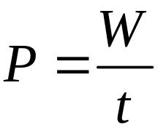
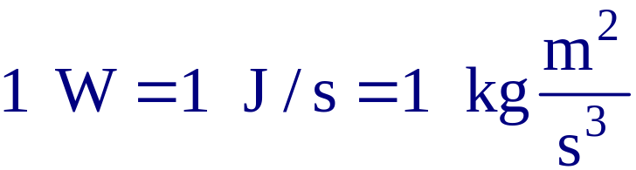
Power
Power is rate of energy transfer
SI units are Watts (W)
US Customary units are hp (horse power)

Slide 26
Example 5.10
An elevator of mass 550 kg and a counterweight of 700 kg lifts 23 drunken 80-kg students to the 7th floor of a dormitory 30 meters off the ground in 12 seconds. What is the power required?
(in both W and hp)
41 kW =55 hp

Slide 27
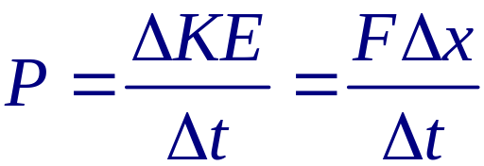

Power: Force and velocity
For the same force, power is higher for higher v

Slide 28
Example 5.13
A physics professor bicycles through air at a speed of
v=36 km/hr. The density of air is 1.29 kg/m³. The professor has cross section of 0.5 m². Assume all of the air the professor sweeps out is accelerated to v.
a) What is the mass of the air swept out by the professor in one second?
b) What is the power required to accelerate this air?
a) 6.45 kg b) 323 W = 0.432 hp

